Slide 1


Net Zero & DRI

Slide 2
Acknowledgements
Sophie Clay, NCAS Environmental Sustainability Manager
David Brownless, Software Developer, ISIS Computing Division, STFC

Slide 3
Net Zero - what is it?
Definition:
Net zero refers to achieving a balance between the amount of greenhouse gas emissions produced and the amount removed from the atmosphere, resulting in no net increase in emissions.
Importance
Mitigating climate change is a global priority, and digital research infrastructure users can play a crucial role.
Digital technology and internet are responsible for around 4% of global carbon emissions

Slide 4
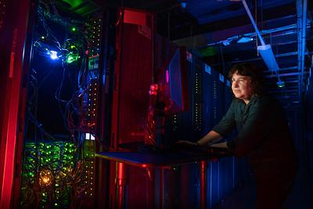
What is digital research infrastructure (DRI)?
The building blocks of the digital research infrastructure system include:
Large scale computer facilities, including high-throughput, high-performance, and cloud computing
Data storage facilities, repositories, stewardship and security
Software and shared code libraries
Mechanisms for access, such as networks and user authentication systems
People: the users, and the experts who develop and maintain these powerful resources

Slide 5

Key areas contributing to digital research infrastructure emissions
Embodied carbon in equipment
Manufacture of hardware (including the footprint of extracting raw materials)
Emissions associated with the use of electricity to power computer equipment
Energy for power distribution and cooling storage

Slide 6
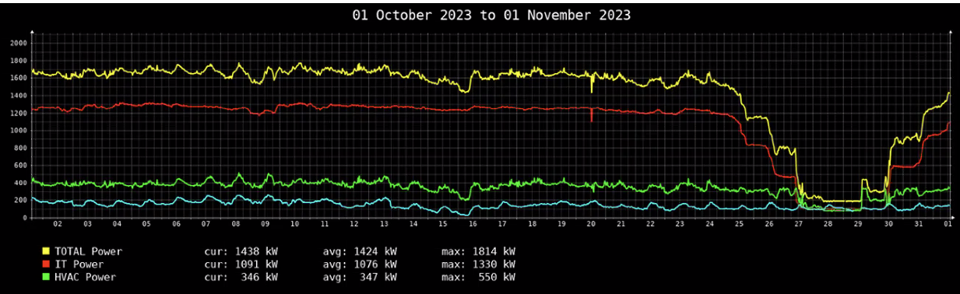
An example - power usage in the JASMIN building

Slide 7
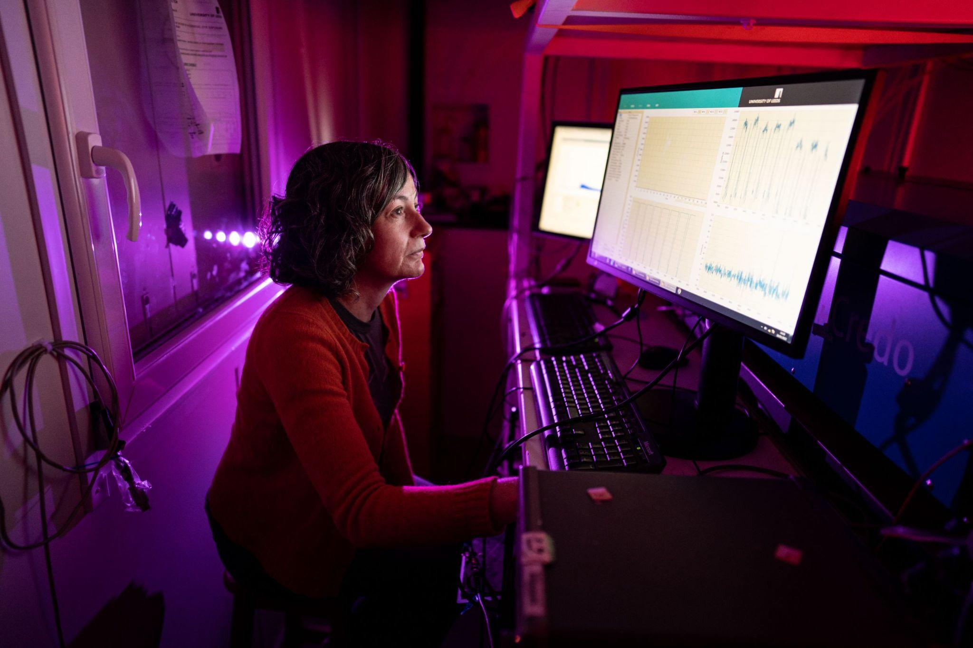
Actions you can take
Reduce Energy Consumption
Optimise server utilisation
Ensure efficient use of computational resources to minimise energy waste
Implement power-saving features
Configure hardware and software to reduce energy consumption during idle periods

Slide 8
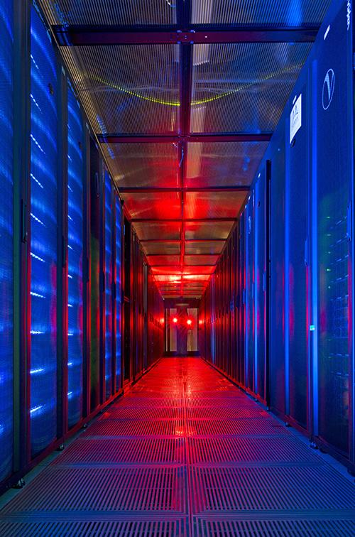
Actions you can take: efficient data storage and usage
Don’t make multiple copies of big data!
Provide links to where the data are stored rather than attaching multiple copies to emails
A JASMIN Group Workspace (GWS) can be used to collaborate with co-workers
Think about what data really need to be stored in the long-term (Data Management Planning)
Tape storage is more energy efficient than disk storage
When processing - subset your data

Slide 9

Actions you can take: green software engineering
Code efficiency
Write energy-efficient code to reduce computational demands
Sustainable algorithms
Develop and use algorithms that minimise energy and resource consumption
Green Software Engineers – a profession for the future

Slide 10
Green software engineering principles
Sustainable Software Engineering aims to reduce the total emissions of computing across the complete lifecycle of the project (its Digital Carbon Footprint)
There are three main targets for reducing this footprint:
Energy efficiency. Design software to use the least amount of electricity.
Hardware efficiency. Reduce embodied carbon by requiring less powerful or substantial hardware resources.
Carbon awareness. Facilitate the use of cleaner energy sources where possible.
The goal is to both reduce energy consumption and increase the longevity of hardware: https://learn.greensoftware.foundation/
Notes:
In itself, software is rarely a direct source of GHGs, however direct and indirect energy consumption of software development and use, and embodied carbon of manufacture and disposal of computer hardware make IT a significant contributor.

Slide 11
Sustainable Software Patterns
Ways to make your software greener:
Reducing the computation performed through caching or pre-calculating results of common operations
Use less complex user interfaces that react to users rather than perform to them
Using signals instead of polls (i.e. push notifications), data reduction and server-side processing to eliminate unnecessary network traffic
Sometimes client-side processing is more efficient, e.g. drawing a graph of a dataset
Removing bandwidth hogs like video and audio, photos, rendered images, etc.
Using scheduling or queuing, or remote procedure calls to move the most intensive operations to less polluting times or locations
Enhancing responsiveness and useability to design in support for diversity and accessibility from the outset (i.e. not something you have to add on later)

Slide 12
Why Sustainability includes EDI
Sustainable development is development that meets the needs of the present without compromising the ability of future generations to meet their own needs. – The Brundtland Report, UN (WCED)
In 2017, The UN proposed 17 Sustainable Development Goals (SDGs) as a ‘roadmap’ combating violent conflict, inequality, and environmental degradation, including climate change: https://www.un.org/sustainabledevelopment/
The UN goals emphasised a view that sustainable development combines social benefits and environmental protection with economic growth
It is not considered sustainable to sideline the needs and contributions of disadvantaged or marginalised populations
Notes:
Development can’t benefit the few while the costs are borne by all. Duplication, or more, of efforts to facilitate perpetuation of exclusion or division is inherently inefficient.
Immediate privation must be addressed if we are to secure engagement with the long-term requirements of future generations.

Slide 13
Accessibility tools
Some automated assistance is available:
Web accessibility checkers such as Axe, EqualWeb, Lighthouse, and WAVE.
Software GUI checkers like Accessibility Insights (.NET), Accessibility Inspector (KDE) or Accerciser (Gnome)
Inclusive language parsers such Trinka and Witty, and there is built-in support in MSWord.
Internationalization and pseudo-localization libraries exist for React, Angular, and Django, etc.
But…
There is a strong focus on web accessibility, with much less coverage of other categories.
Anything but basic functionality is frequently chargeable.
Several use external AI models to perform their analysis
Use the tools (carefully) but don’t rely just on them.
They only analyse the code, not a user’s experience, they can be fooled.
The diversity of needs can mean some users’ requirements might conflict of be unachievable.

Slide 14
AI: why prompt engineering matters
Google estimates that every query processed by its AI tools releases a median 0.03 g CO₂ (source https://ioaglobal.org/blog/google-gemini-energy-footprint/)
Overview of this topic: Are LLMs destroying the planet? - Softwire
Users typically send multiple queries to refine or focus the results of generative AIs
Much of this repetition could be avoided through effective prompt engineering
The (very) basics of prompt engineering is to specify a goal, context, sources and expectations
Goal (What): Define the purpose and scope “Give three examples of using AI tools to improve accuracy of data cleaning tasks”
Context (Who): Specify the target consumer’s skill level or interest. “for graduate data scientists familiar with Python and Pandas, but new to using LLMs. The examples should include real world data science tasks.”
Sources (With): Constrain the types of input data used. “Use as recent posts from OpenAI, academic papers, and case studies from Kaggle, and avoid outdated or generic advice.”
Expectations (How): Set content and style requirements. “Include a section on avoiding common mistakes and end with a checklist for effective prompts. Be clear, professional, and use minimal jargon.”
https://help.openai.com/en/articles/6654000-best-practices-for-prompt-engineering-with-the-openai-api
Notes:
Google’s figure does ignore a lot of embodied carbon (e.g. training the AI) and other factors, but the transparency of actually publishing the figure is good. Also, they say it has been independently verified.

Slide 15
Actions you can take to reduce your own digital carbon footprint
The key point is that many (although not all) of these are choices that you can make in your own decisions about software design and data handling

Slide 16
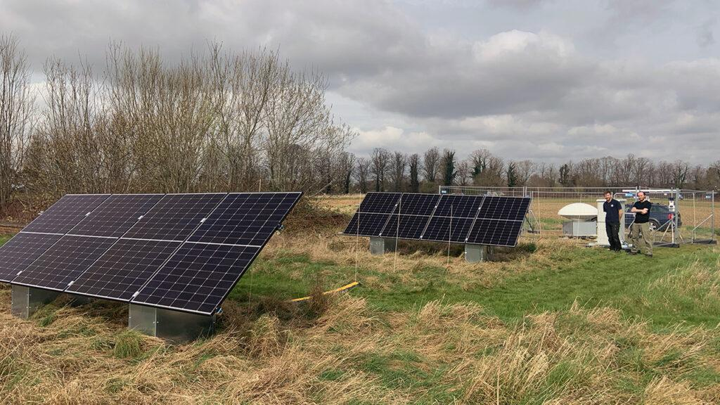
Actions NCAS is taking at an organisational level
On 17th October 2024 NCAS signed the Concordat for the Environmental Sustainability of Research and Innovation Practice.
The specific aims of the concordat include:
Leadership in environmental sustainability: Providing visible and credible sustainability leadership throughout institutions and across the sector.
Sustainable practices in research: Implementing low-carbon research methods, embracing new ideas and technologies, and incorporating sustainable practices from the outset of each project.
Net-Zero carbon infrastructure: Transitioning to research facilities that aim for net-zero carbon, using robust carbon sequestration where necessary.
Responsible sourcing and circular economy: Making informed choices about resources and materials based on their lifecycle, sustainability, and responsible sourcing.
https://ncas.ac.uk/ncas-joins-uk-research-sector-initiative-for-environmentally-sustainable-innovation/

